Slide 1
“To Inspire, Equip and Connect Presbyterians in Mission”

Slide 2
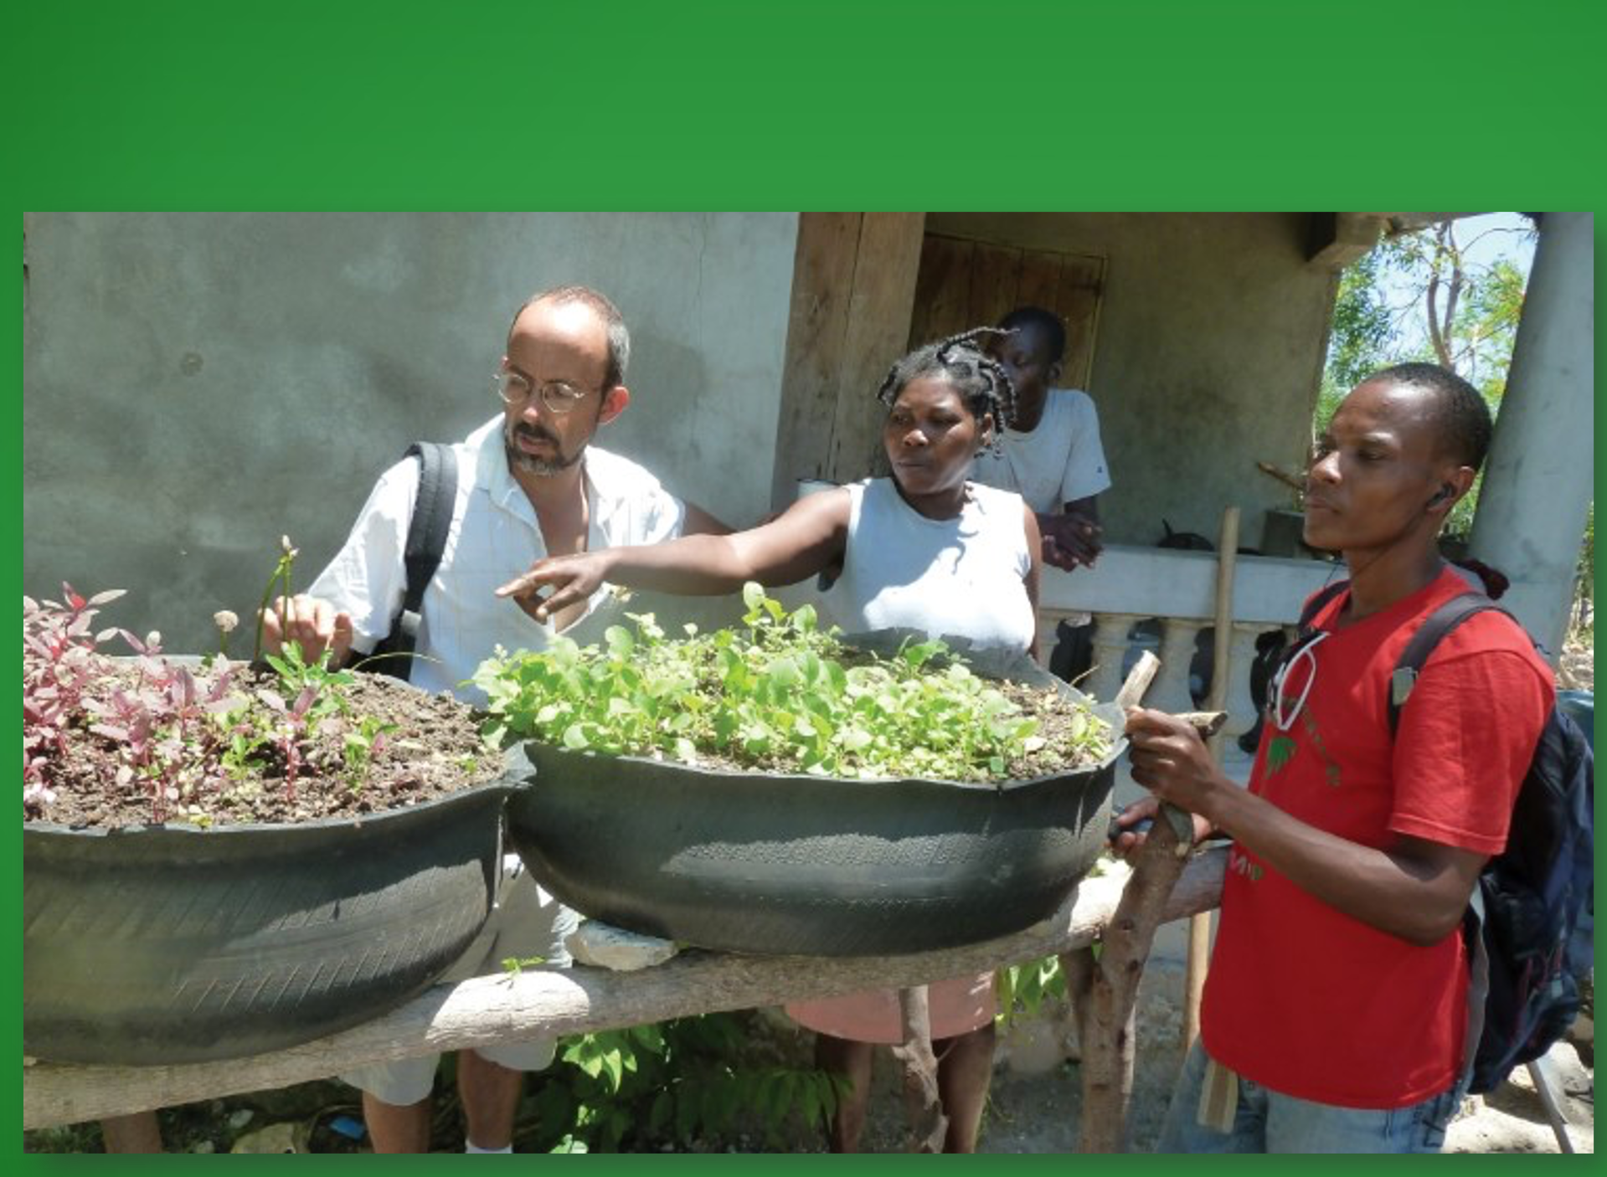
69 Mission Personnel
80 Countries
265 PMA Employees

Slide 3

Presbyterian Church (U.S.A.)
Presbyterian Mission Agency
Notes:
In fulfilling our purpose to inspire, equip and connect God’s people, the mission agency calls the church to be a Matthew 25 Church. The mandate to be a Matthew 25 church first came from the 2016 General Assembly. It has since been adopted and confirmed by GA in 2018, and 2020, and now 2022.

Slide 4
Matthew 25 Growth
1,228 congregations (15%)
11 synods (85%)
86 presbyteries (51%)
70 other groups
Notes:
1,228 churches, 70 groups, 11 synods of the 13 programmatic synods, and 86 presbyteries.
That is 15% of congregations, 85% of synods and 51% of presbyteries.

Slide 5
Three Primary Foci
Building Congregational Vitality
Dismantling Structural Racism
Eradicating Systemic Poverty

Slide 6
Congregational Vitality
A community’s spiritual strength and demonstrated capacity for engaging in purposeful mission.
Notes:
You can tell how vital your congregation is by asking this question, “If you were to close down today, who, besides those already in your church, would miss you?

Slide 7
Systemic Poverty
Exploitation of people through
laws, policies, and practices that lead to the
perpetuation of poverty.
Notes:
Systemic poverty may be defined as a human construct designed to exploit people through laws, policies, practices that lead to the perpetuation of an impoverished status.

Slide 8
Structural Racism
Normalization and Legitimization of
Dynamics and Systems—producing adverse outcomes for people of color.
Notes:
Structural Racism is defined as a social construct that normalizes and legitimizes an array of dynamics—historical, cultural, institutional and interpersonal—that routinely advantages whites while producing cumulative and chronic adverse outcomes for people of color.
If is said, If one fish washes up on the shore, you say what’s wrong with that fish, but if a school of fish wash up on the shore, you say what’s wrong with the water. Clean up the water so the fish can swim free.
Structural Racism is not primarily about individual prejudice or an individual’s beliefs and attitudes. Rather, racism in the U.S. is a socially constructed system.

Slide 9
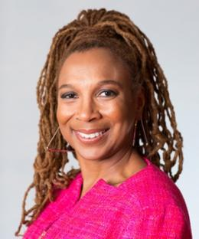
Intersectionality
Intersectionality
Kimberly Crenshaw
"Intersectionality is a metaphor for understanding the ways that multiple forms of inequality or disadvantage sometimes compound themselves and create obstacles that often are not understood among conventional ways of thinking.“
Notes:
Kimberly Crenshaw is a scholar and writer on civil rights, critical race theory, Black feminist legal theory, and race, racism and the law. – At Columbia Law School

Slide 10
Three Intersecting Foci
Climate Change
Militarism
Gender Discrimination
Hetero-patriarchy

Slide 11
Climate Change
Shift in temperatures and weather patterns caused by human activities such as burning fossil fuels like coal, oil and gas.
Notes:
Presbyterians for Earthcare
The PC(USA) has long recognized our obligation to take actions as faithful stewards of God’s Creation to respond to climate change. General Assembly actions in 1981, 1998, 1999, 2003, 2006, 2008, 2010, 2012, 2014, 2016, and 2018 acknowledge the realities of global warming, its effect on the “least of these,” and the need to reduce energy consumption and reliance on fossil fuels.
Climate change intersects with systemic poverty and structural racism. Climate change is a particularly acute threat for countries in Sub-Saharan Africa and South Asia—regions where most of the global poor are concentrated. It is estimated that 821 million people (1 in 9 of the world’s population) do not get enough to eat.
The PMA’s work addressing the climate crisis in 2023–2024 will align with the goals of the Paris Agreement to limit global average temperature to an increase of no more than 1.5 degrees Celsius from preindustrial levels through education, advocacy, training, and partnerships, primarily through critical intersections with building congregational vitality, dismantling structural racism, and eliminating systemic poverty.

Slide 12
Militarism
A system of beliefs, political priorities and economic investments correlated with inordinate expenditures on weapons, undue influence by the defense establishment on setting national priorities, the suppression of human needs, and legitimate protests of evils committed against underserved communities.
Notes:
Presbyterian Peacemaking –
The General Assembly has offered much language related to militarism over the years. In 2010 it initiated the Peace Discernment Process which produced a number of papers, studies, and resources for congregations throughout the PC(USA). Other General Assemblies in 1980, 1982, 1998, 2004, 2008, 2010, 2012 and 2014 weighed in on issues around militarism in the areas of peacemaking, human rights, drone warfare, divestment related to war and militarism, and ways to support our international partners in the disproportionate ill-effects of militarism on their local communities. In 2010 the major PC(USA) policy paper on gun violence was passed which forms the foundation for our concerns around policing and militarism in the United States.
Militarism is a term that is misunderstood by many, but refers to a “system of beliefs, political priorities and economic investments.” Militarism is often correlated with inordinate expenditures on weapons, undue influence by the defense establishment on setting national priorities, the suppression of human needs, and legitimate protests of evils committed against underserved communities. The domestic impacts of militarism are often overlooked but can be seen in militarized police forces and the demonization of the “other” to justify denial of human rights to repressed peoples and inequality of treatment for marginalized populations.
The PMA’s work in 2023–2024 will examine and confront militarism through the lens of the Christian faith from a variety of intersectional perspectives, including racism, poverty, climate change, and gender oppression. Recognizing the unique resource of specialized ministers serving and having served as chaplains in the uniformed services, the PMA will invite their expertise alongside longtime international and domestic partners to engage in education, advocacy, and partnership within and beyond the PC(USA) to address the dangers and impacts of a militaristic mindset from a Christological perspective.

Slide 13
Heteropatriarchy/ Gender Discrimination
A society dominated by white cisgender heterosexual males whose characteristic bias is unfavorable toward women, people of differing genders, and the LGBTQIA+ community.
Notes:
“Intersectional Justice: Exploring Gender & Racial Justice in a Matthew 25 Context” will be offered three times in 2022, starting April 26. Additional sessions are being offered July 13 and Sept. 14. This is three offerings of the same content, not a series. Registration is capped for each session.
Though the United States is becoming an increasingly diverse country, we still live in a society dominated by white cisgender heterosexual males whose characteristic bias is unfavorable toward women, people of differing genders, and the LGBTQIA+ community. The context of work for gender equity and freedom from heteropatriarchy is a human situation that extends beyond our nation. In all corners of the world, women experience injustice because they are women. LGBTQIA+ people experience injustice because of their gender and sexual identities. And gender nonbinary people experience injustice because they do not fit into the categories of male or female.
The PC(USA) is committed to work against gender-based discrimination and heteropatriarchy. The Book of Order states: “In Christ, by the power of the Spirit, God unites persons through baptism regardless of race, ethnicity, age, sex, disability, geography, or theological conviction. There is therefore no place in the life of the Church for discrimination against any person” (F-1.0403).

Slide 14
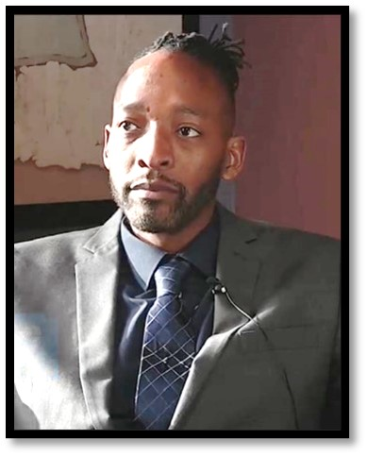
Center for Repair of Historical Harm
Rev. Jermaine Ross-Allam, Director
Notes:
One of the first efforts for the Center of Repair was in Juneau, Alaska closing of the church serving the Lingit (Clinkit) people. At the same time Presbytery gave $200,000 to the Northern Light PC (white church) and told the Lingit people to join that church. Repair nearly 1 million dollars money for healing, cultural preservation and education for native Americans.

Slide 15

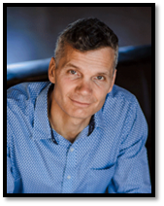
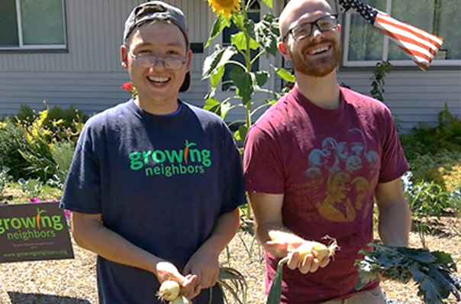
Office of Innovation
INNOVATE
Dr. Corey Schlosser –Hall, Director
Notes:
In 2023 we are also launched the Office of Innovation. We are partnering with Rooted God to help church’s implement best practices for
1) renting and leasing property to advance God’s mission and increase revenue;
2) working with a property developer; and
3) considering the tax implications of new revenue and partnerships.

Slide 16
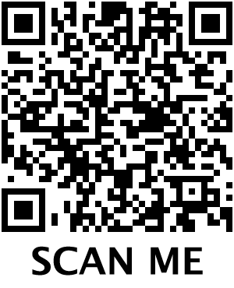


pcusa.org/matthew25
Notes:
September 28, 2024 – Grace Presbytery/Canyon Creek Presbyterian Church in Dallas, Texas
Keynote- Corey Schlosser-Hall
Workshops –Lemuel Garcia + DeEtte Decker
October 26, 2024 – Baltimore Presbyter + National Capital Presbytery in Baltimore, Maryland
Keynote - Jermaine Ross-Allam
Workshops – Samantha Davis, Carlton Johnson + DeEtte Decker

Slide 17
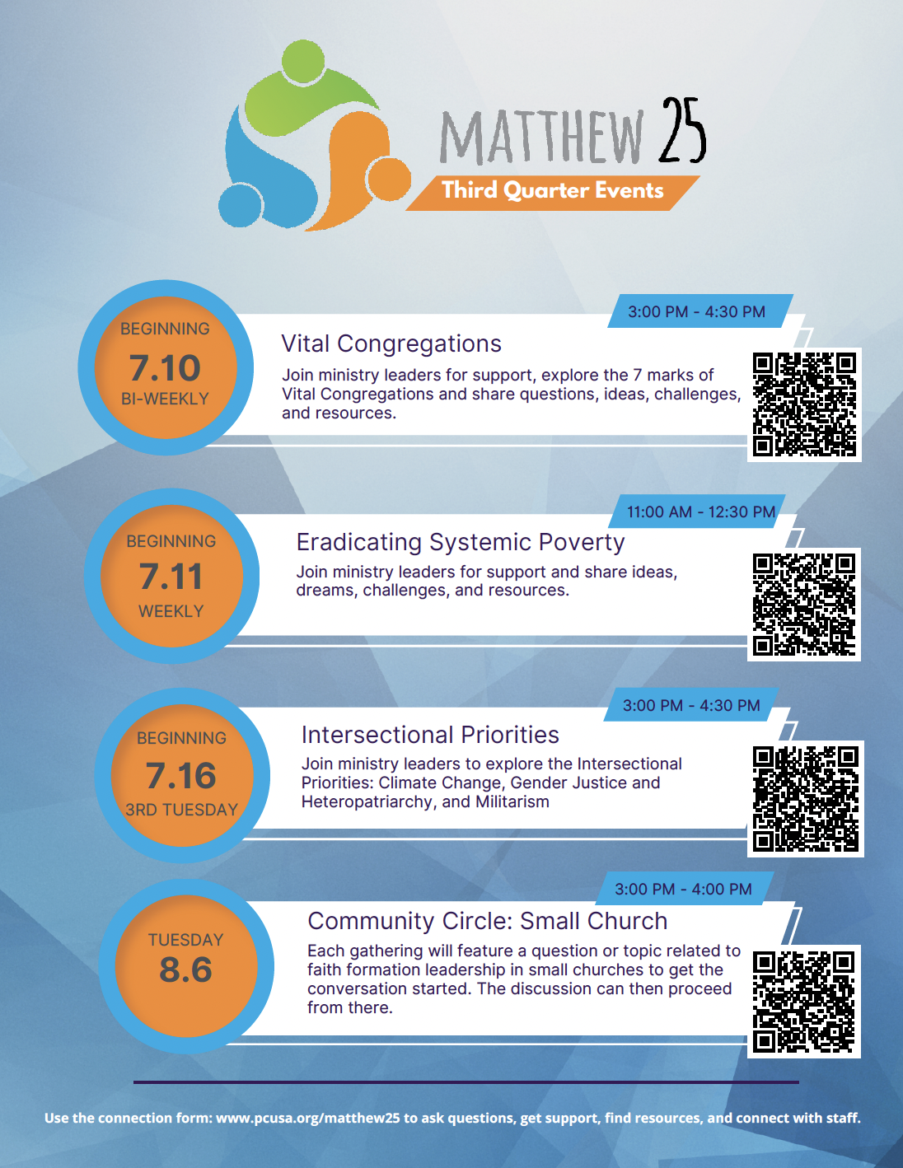

Slide 18
Why Matthew 25?
Clarify
Contextualize
Connect
Celebrate
Notes:
Clarity of Mission 2. Contextual – large enough for everyone to lean in, but small enough to contexualize 3. Connectional National, Regional and local Platform

Slide 20
Stories25?
New Life for New River PC
in West Philadelphia, PA:
https://vimeo.com/956627311
Apologies and Repair in Juneau, AK
https://vimeo.com/969327048

Slide 21
Questions?
What Stands out for you?
What is your church doing or may do to bear witness to Christ?

Slide 22
How to Join Matthew 2525?
Share Matthew 25 with your congregation or entity.
Gain approval from your governing body.
Go to pcusa.org/matthew25, click “Join Matthew 25”
Enhance and discover ways to live into
Matthew 25

Slide 23
How to Join Matthew 2525?
For more information please contact:
Debbie Gardiner, Executive Assistant
Office of the President/Executive Director
Debbie.Gardiner@pcusa.org 502.569.5988

Slide 24
Thank You!

